Slide 1

Binary to Octal Conversion
Notes:
Welcome to today's lecture on Binary and Octal number systems. These are the foundational languages of digital circuits. We will explore how computers represent data using these specific bases. Understanding these systems is crucial for designing basic digital logic.

Slide 2
SLIDE 2 / 10
Course Outcome
CO | BT LEVEL | DESCRIPTION
CO1 | BT3 | Apply number systems and digital logic to design basic digital circuits
CO2 | BT4 | Analyze register organization and instruction set architecture
CO3 | BT3 | Implement computer arithmetic algorithms and floating-point operations
CO4 | BT5 | Analyze memory hierarchy and input-output organization
CO5 | BT6 | Evaluate control unit design and pipelining performance
2 / 10
Notes:
Today's lecture directly supports Course Outcome 1. You will learn to apply number systems like binary and octal to design basic digital circuits. This skill is essential for understanding how hardware processes information. We will see how these abstract numbers translate into physical logic gates.

Slide 3
Learning Objectives
SLIDE 3 / 10
Learning Outcomes
1
Define the binary number system with base-2 structure
2
Explain the octal number system with base-8 structure
3
Convert decimal numbers to binary then octal structutre.
4
Convert binary numbers to octal using grouping techniques
5
Find the relationship between binary and octal digits
Chandigarh University
3 / 10
Notes:
By the end of this session, you will be able to define both binary and octal systems clearly. You will learn to convert between decimal, binary, and octal formats accurately. We will focus on the grouping technique which simplifies binary-to-octal conversion. These skills are vital for analyzing digital data representation.

Slide 4
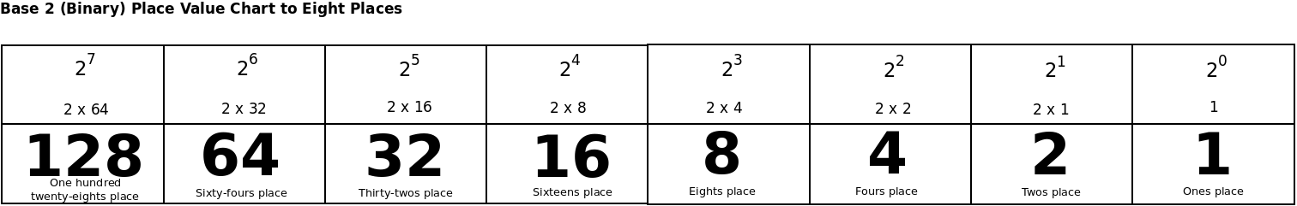
Lecture
SLIDE 4 / 10
Binary Number System Basics
1
Binary number system uses base 2 i.e 0 and 1
2
Each position represents a power of 2 starting from 2⁰ (1,2,4,8,16...)
3
The rightmost bit is the Least Significant Bit (LSB)
4
The leftmost bit is the Most Significant Bit (MSB)
5
The native language of all digital electronic circuits is Binary.
Irts power of 2
Chandigarh University
4 / 10
Notes:
The binary system is the simplest number system using only two symbols. Think of a light switch that is either off (0) or on (1). Each position in a binary number represents a doubling value. For example, the number 101 represents 1×4 + 0×2 + 1×1 which equals 5 in decimal.

Slide 5
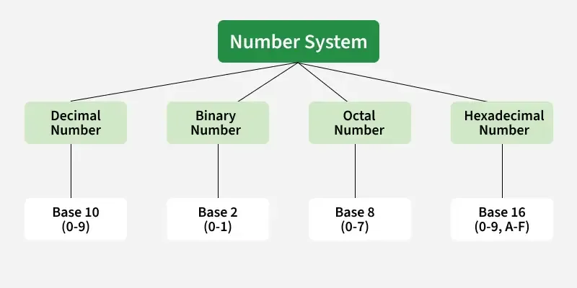
Lecture
SLIDE 5 / 10
Octal Number System Basics
1
Octal uses base 8 with digits ranging from 0 to 7.
2
Each position represents a power of 8 starting from 8⁰
3
Octal is used as a shorthand for binary representation
4
One octal digit corresponding exactly to three binary bits
5
It justify reading long binary strings in computer systems
Source: media.geeksforgeeks.org
Chandigarh University
5 / 10
Notes:
Octal is a base-8 system using digits 0 through 7. It serves as a convenient shorthand for binary because three binary bits always equal one octal digit. For instance, the binary group 111 is exactly the octal digit 7. This makes it easier for engineers to read memory addresses.

Slide 6
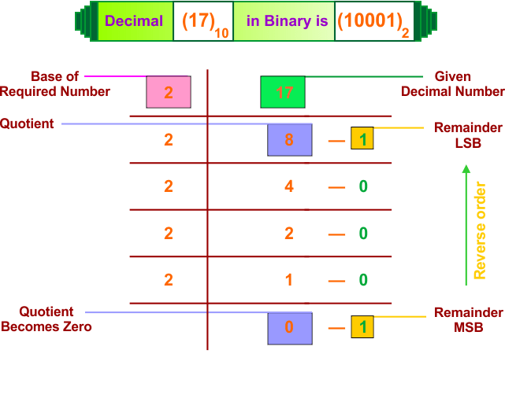
Lecture
SLIDE 6 / 10
Decimal to Binary Conversion
EXAMPLE
Decimal 14 converts to binary 1110
• Repeatedly divide the decimal number by 2 and record remainders
• The first remainder obtained is the Least Significant Bit (LSB)
• The last remainder obtained is the Most Significant Bit (MSB)
• Read the remainders from bottom to top to find the result.
Source: cstaleem.com
Chandigarh University
6 / 10
Notes:
To convert decimal to binary, we use the repeated division method. Let's convert the decimal number 13 to binary. We divide 13 by 2 to get 6 remainder 1. Then 6 divided by 2 is 3 remainder 0. Continuing this process gives us the binary sequence 1101 reading from bottom to top.

Slide 7
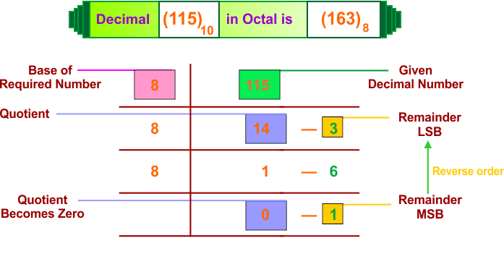
Lecture
SLIDE 7 / 10
Decimal to Octal Conversion
EXAMPLE
Decimal 25 converts to octal 31
• Repeatedly divide the decimal number by 8 & record remainders
• The first remainder obtained is the Least Significant Octal digit
• The last remainder obtained is the Most Significant Octal digit
• Read the remainders from bottom to top to get the result
Source: cstaleem.com
Chandigarh University
7 / 10
Notes:
Converting to octal follows the same logic but uses division by 8. Let's convert the decimal number 25 to octal. We divide 25 by 8 to get 3 remainder 1. Then 3 divided by 8 is 0 remainder 3. Reading the remainders from bottom to top gives us the octal number 31.

Slide 8
Lecture
SLIDE 8 / 10
Binary to Octal Conversion
EXAMPLE
Binary 110101 converts to octal 65
• Grouping binary digits into sets of three starting from the LSB.
• Adding leading zeros to the left if the last group has fewer than three bits
• To Convert each 3-bit group directly into its corresponding octal digit
• To Combine the octal digits to form the final octal number
Chandigarh University
8 / 10
Notes:
Converting binary to octal is very efficient using the grouping method. Take the binary number 110101 and group it from right to left as 110 and 101. The group 110 equals 6 in octal, and 101 equals 5. Therefore, the binary number 110101 is exactly 65 in octal. This method avoids complex division calculations.

Slide 9
Lecture
SLIDE 9 / 10
Key Takeaways
1
Binary uses base 2 (0,1) while Octal uses base 8 (0-7)
2
One octal digit is equivalent to exactly three binary bits
3
Division method converts decimal to binary or octal systems
4
Grouping method converts binary to octal efficiently
5
These systems are fundamental for digital circuit design and logic
Chandigarh University
9 / 10
Notes:
To summarize, binary and octal are essential number systems for computer organization. Remember that octal is a compact representation of binary using groups of three bits. You can convert between decimal and these systems using division or grouping techniques. Mastering these conversions is key to designing digital circuits.

Slide 10
Lecture
SLIDE 10 / 10
References
COMPUTER ORGANIZATION AND DESIGN
The Hardware/Software Interface — David A. Patterson, John L. Hennessy
COMPUTER ARCHITECTURE
A Quantitative Approach — John L. Hennessy, David A. Patterson
• Computer Organization and Architecture — William Stallings
• Computer System Architecture — M. Morris Mano & Rajib Mall
• Computer Organization — Carl Hamacher, Zvonko Vranesic, Safwat Zaky
Chandigarh University
10 / 10
Notes:
These textbooks provide comprehensive coverage of number systems and digital logic. William Stallings and M. Morris Mano are excellent resources for foundational concepts. David A. Patterson's works offer deep insights into hardware-software interfaces. Please refer to these books for further study and practice problems.

